Slide 1


A Quadcopter with Autonomous Take-off and Landing on a Mobile Robot Platform
Supervised by: Dr. Migara Liyanage
Final Evaluation
S.Mithun - EN13509682
Rathnayake R.M.K.M - EN13043360
Sandaruwan B.A.S. - EN13515522

Slide 2
Presentation Outline
Introduction
Project Overview
Main Objectives
Design & Implementation
Results
Conclusion & Future work
Notes:
Design & implementation
Results

Slide 3
Introduction
This project is part of a bigger project. Which is a quadcopter and a mobile robot combined surveillance system. The combined system works fully autonomously without any human interaction and has a ability to perform given tasks.
This surveillance system can be used military purposes, disaster control, search and rescue and so on.
For this project scope a takeoff procedure, an altitude hold PID controller and a landing procedure for the quadcopter will be implemented.
Using image processing, the x, y coordinates of the mobile robot are estimated and using that data, quadcopter will attempt to follow the mobile robot.
Notes:
More Point form

Slide 4
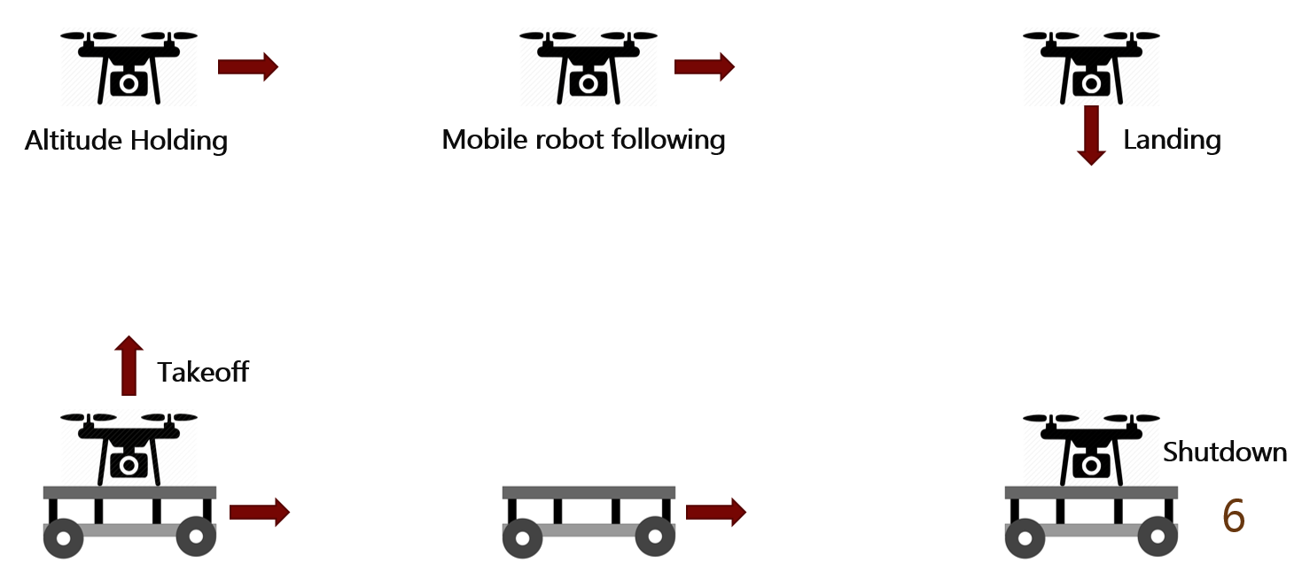
Project Overview
Figure 1. Project Overview
Notes:
Animations of moving

Slide 5
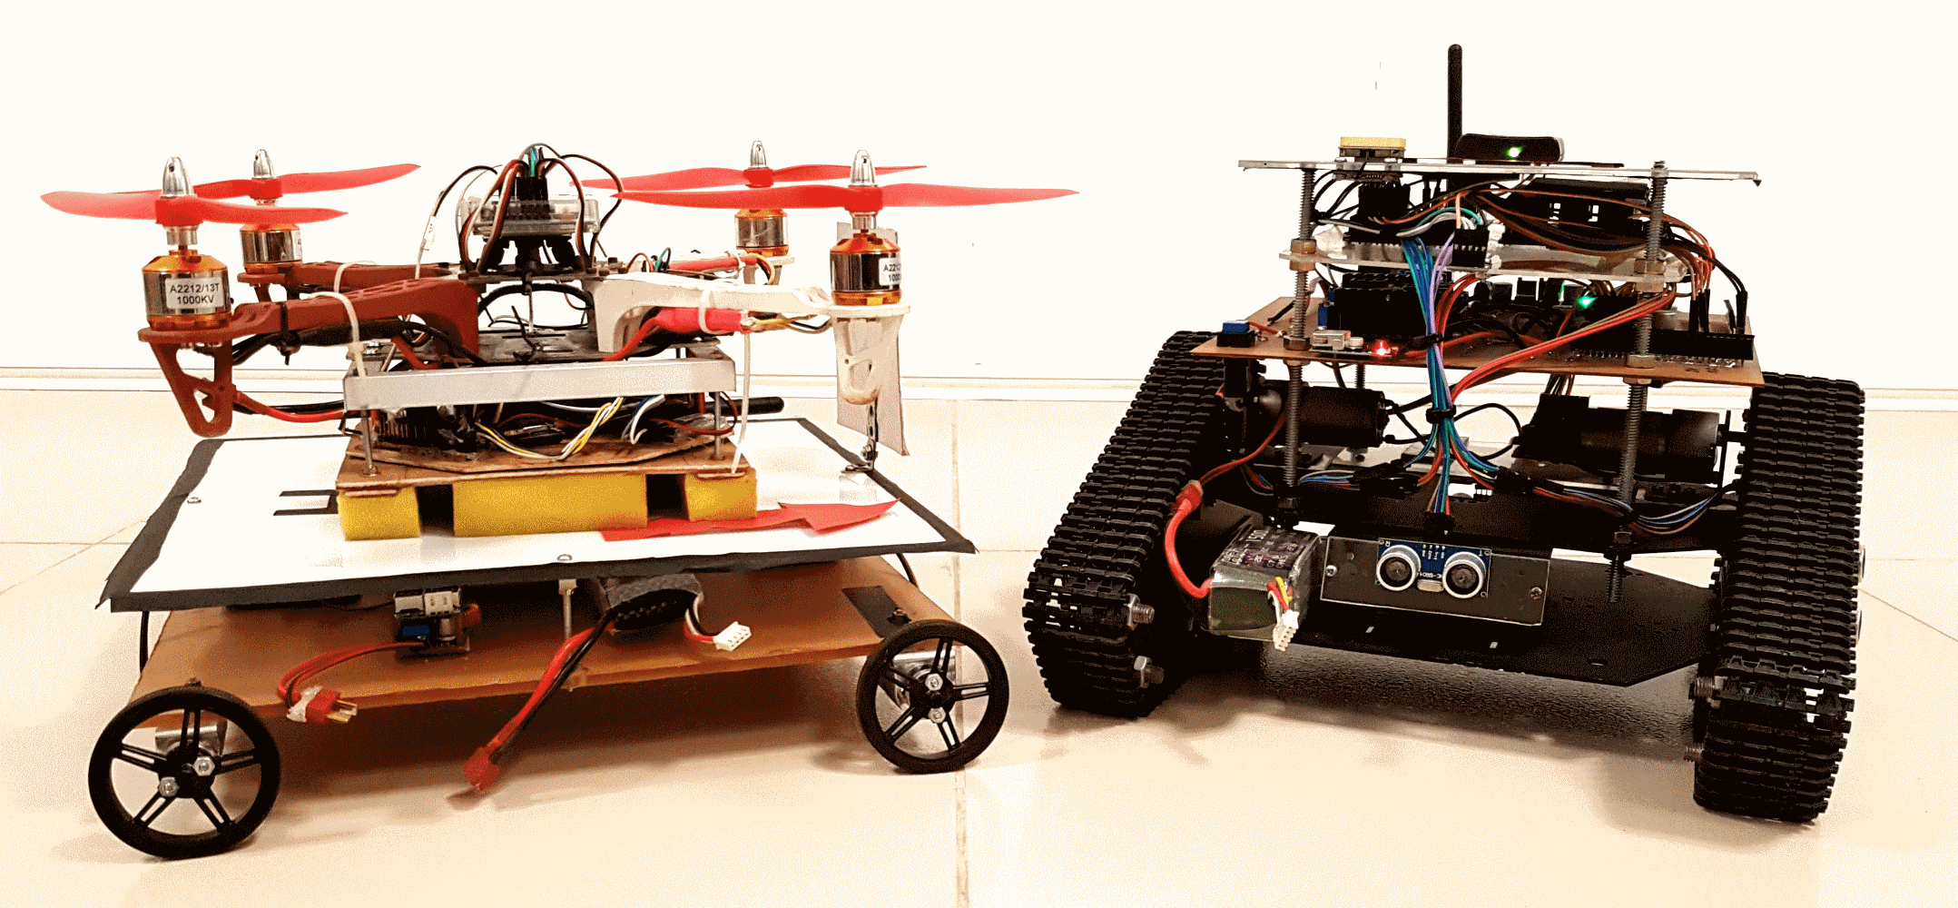
Implemented system
Figure 2. Final System Implementation
Notes:
Animations of moving

Slide 6
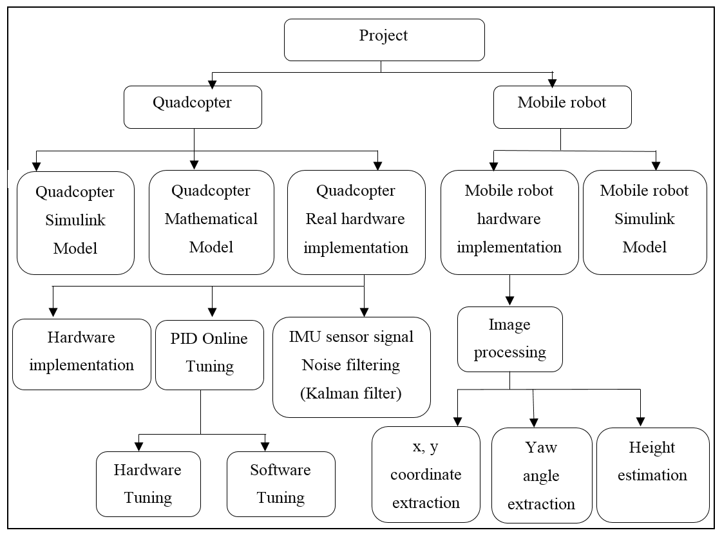
Project flow diagram
Figure 3. Project flow diagram
Notes:
Remove frame
Bottom margin

Slide 7
Main Objectives
Complete simulation of the system in Matlab Simulink
Implementation of an altitude hold PID controller
Implementation of an autonomous takeoff and landing procedures
X, Y coordinates and yaw angle extraction using image processing
Implementation of mobile robot platform

Slide 8
Design & Implementation

Slide 9
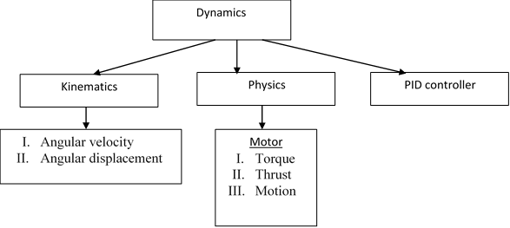
Ideal Quadcopter simulation - Mathematical model
Flow chart of Mathematical model functions

Slide 10
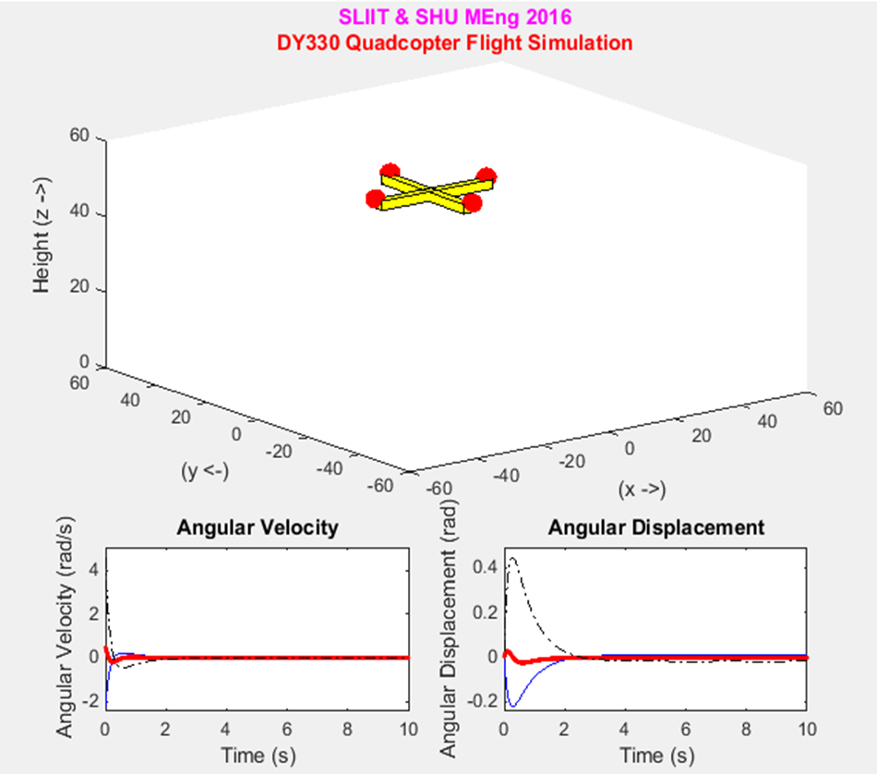
Mathematical Model simulation Model
Controller parameter | Values
P | 8.2
I | 10
D | 8.0
Figure 4. (b) PID values
Figure 4. (a) Mathematical Quadcopter simulation

Slide 11
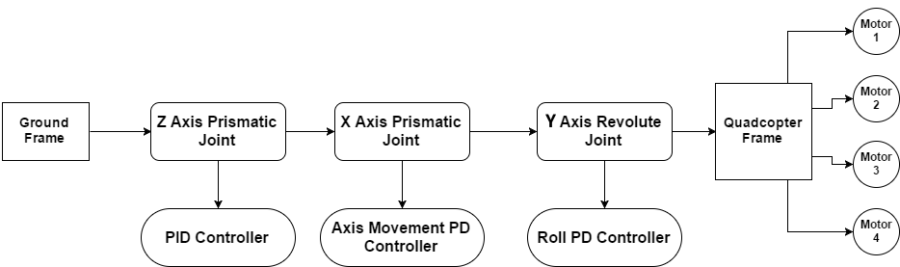
System simulation using Simulink
Figure 6. Block diagram of the full system simulation
Notes:
New slide for motor layout.
Since the actual simulation diagram is much larger, a simple block diagram is used to explain the simulation process. (a) shows how to simulation is done in a simple block diagram. (b) shows the motor layout of a quad. All the block are connected to a ground frame. Then first a prismatic joint is connected to the ground frame, which allows the z axis movement of the quad. The altitude hold PD controller is implemented relevant to this joint. Next another prismatic joint is connected which allows the X axis movement of the quad. The axis movement controller is implemented relevant to this joint. Next a revolute joint is used which allows the quad to turn around Y axis. The Roll PD controller is implemented relevant to this joint. The quadcopter frame is then connected to the revolute joint. Then all the motor are connected to the frame.
(b) Shows the motor layout which is how each motor is placed on the quad.

Slide 12
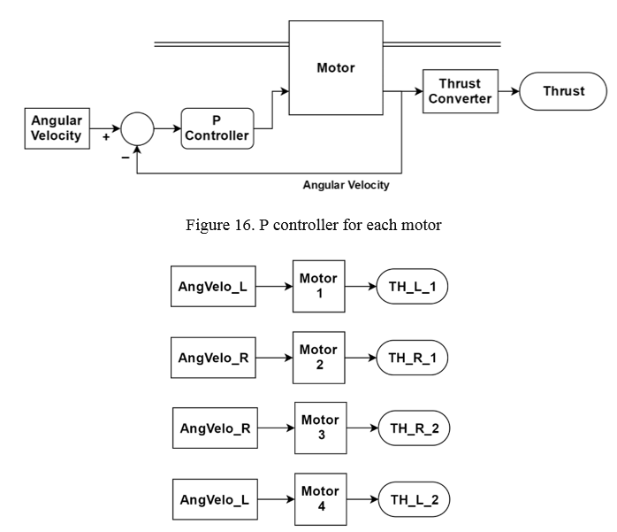
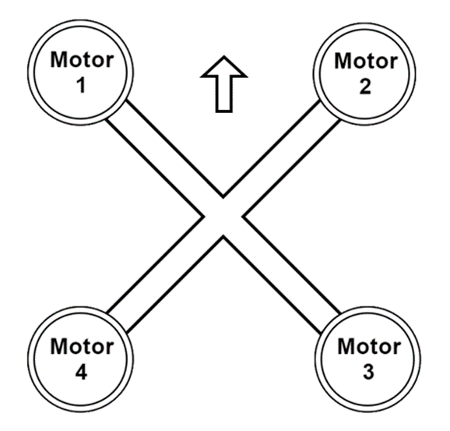
System simulation using Simulink
(a)
(b)
Figure 8. (a) Inputs and Output of each motor (b) motor layout

Slide 13
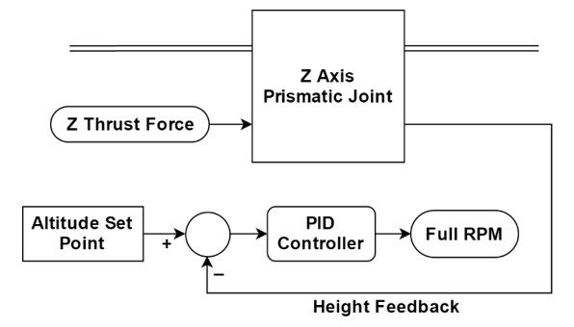
Altitude hold PID controller simulation
Figure 9. Altitude hold PID controller block diagram
Notes:
Block diagram describing how the altitude hold PID controller is implemented in simulation. All the calculations are clearly shows in a future slide. The set point is given in meters. The output of the PID is the full RPM for all the motors. RPM is inserted to all four motors and then the total thrust output from all the motors are calculated. Using full thrust and the roll angle of the quad. The vertical thrust force is calculated and inserted to the prismatic joint here.

Slide 14
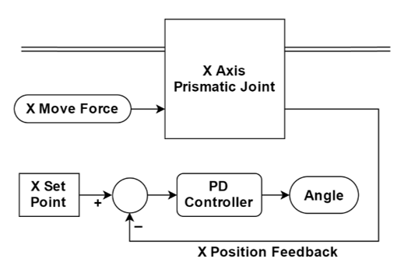
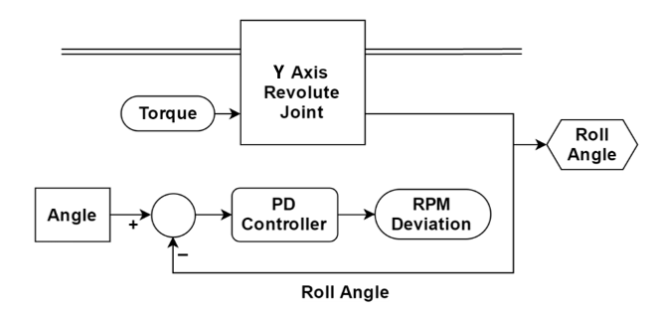
Axis movement & Roll PD controller simulation
(a)
(b)
Figure 10. (a) Axis movement controller (b) Roll PD controller
Notes:
Before implementing the axis movement controller another controller is needed to keep the quadcopter balance around y axis. In the experimental system , this part is done by the primary controller. So in the simulation, it should be implemented separately. Which will be used of the axis movement of the quad. The set point of this controller is the angle which the quad should turn and stay. When the quadcopter is hovering this angle is zero which keep the quad horizontal. The output of the PD controller is the RPM deviation. This will be used with the full RPM generated of altitude hold PID to calculate the new RPM of each motor. At this stage coz of the RPM deviation, a resultant torque will be generated which turns the revolute joint to the given angle. The resultant force in Z direction is used for altitude holding and resultant force in X direction is used for axis movement controller.

Slide 15
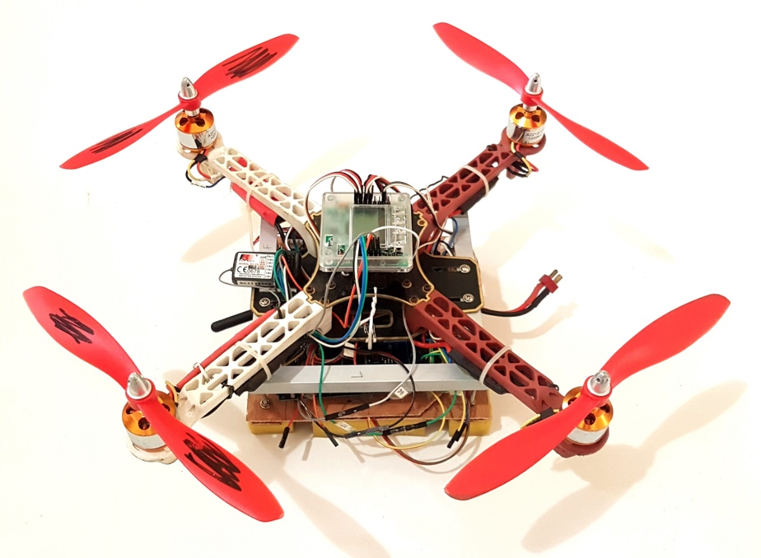
Experimental system implementation
Figure 12. Experimental quadcopter system
Notes:
(a) Is the quadcopter system (b) is the mobile robot platform.

Slide 16
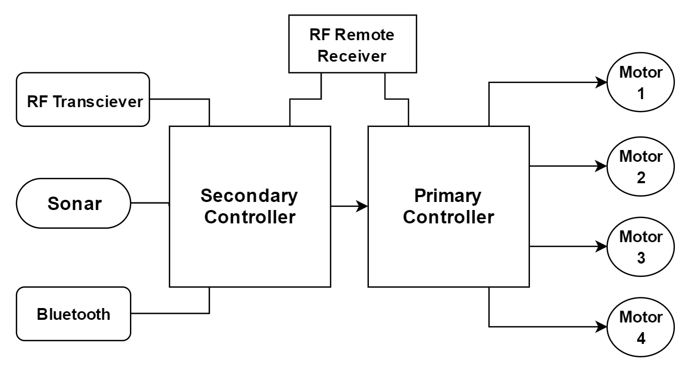
Experimental system implementation
Figure 13. Experimental quadcopter system implementation block diagram

Slide 17
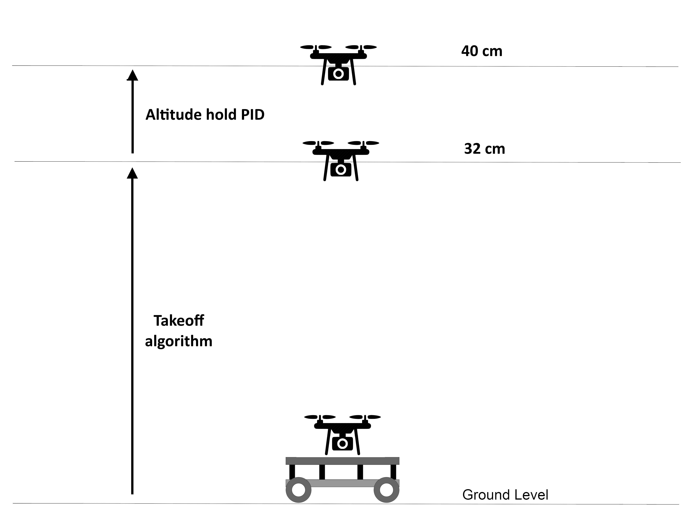
Autonomous takeoff procedure
Figure 14. Takeoff procedure
Notes:
Explain how the takeoff procedure works

Slide 18
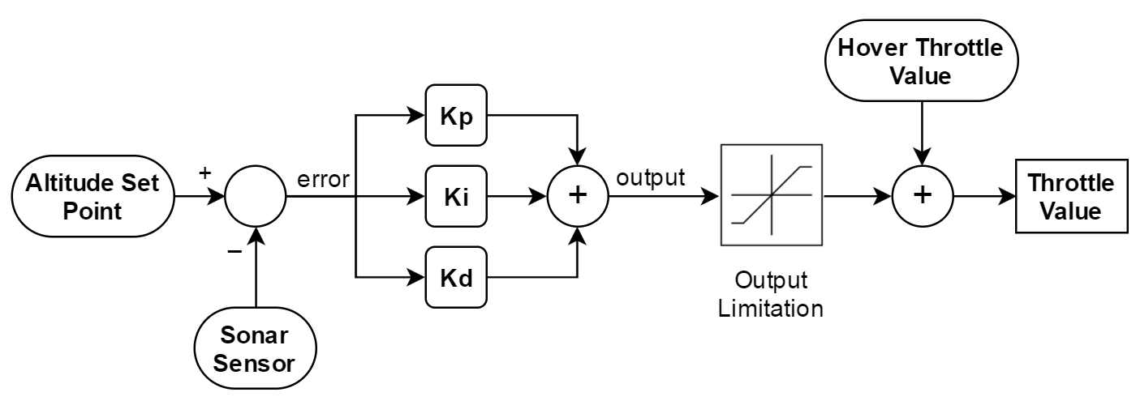
Altitude Hold PID controller
Figure 15. Altitude hold PID controller block diagram

Slide 19
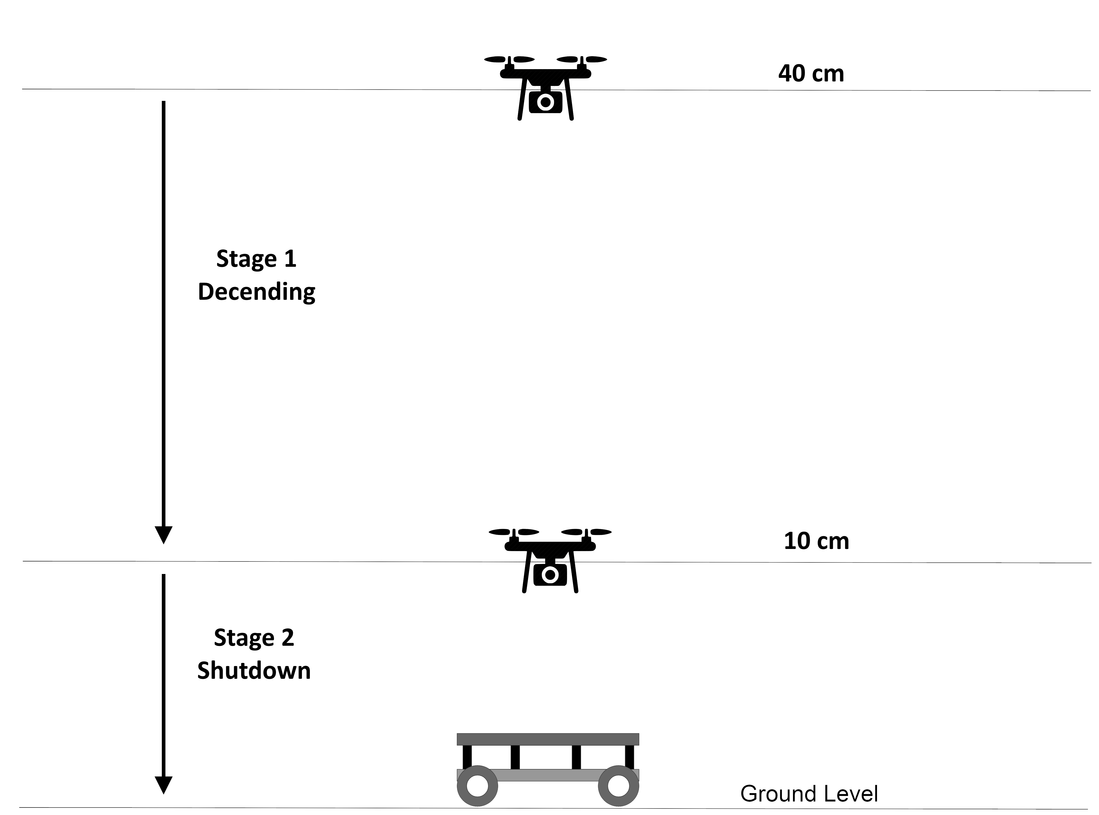
Autonomous Landing procedure
Figure 16. Landing procedure
Notes:
Explain landing procedure.

Slide 20
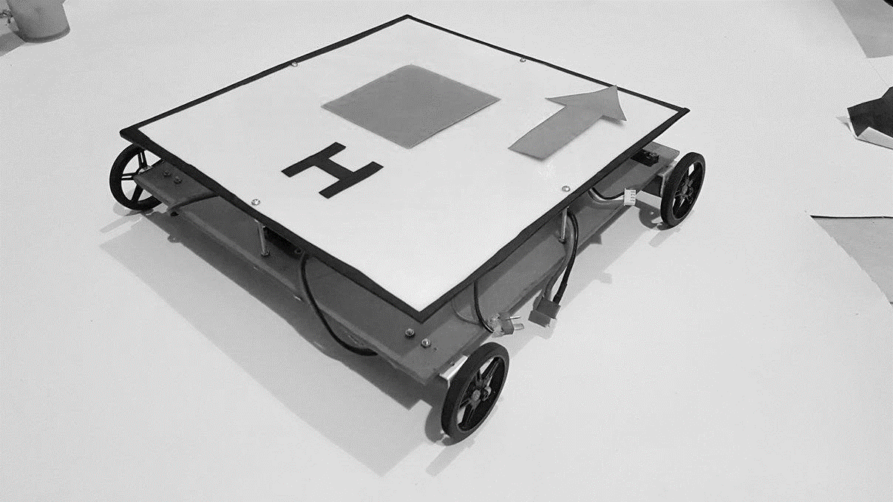
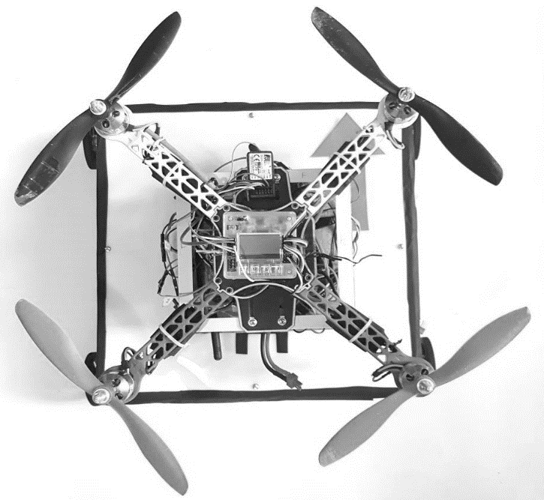
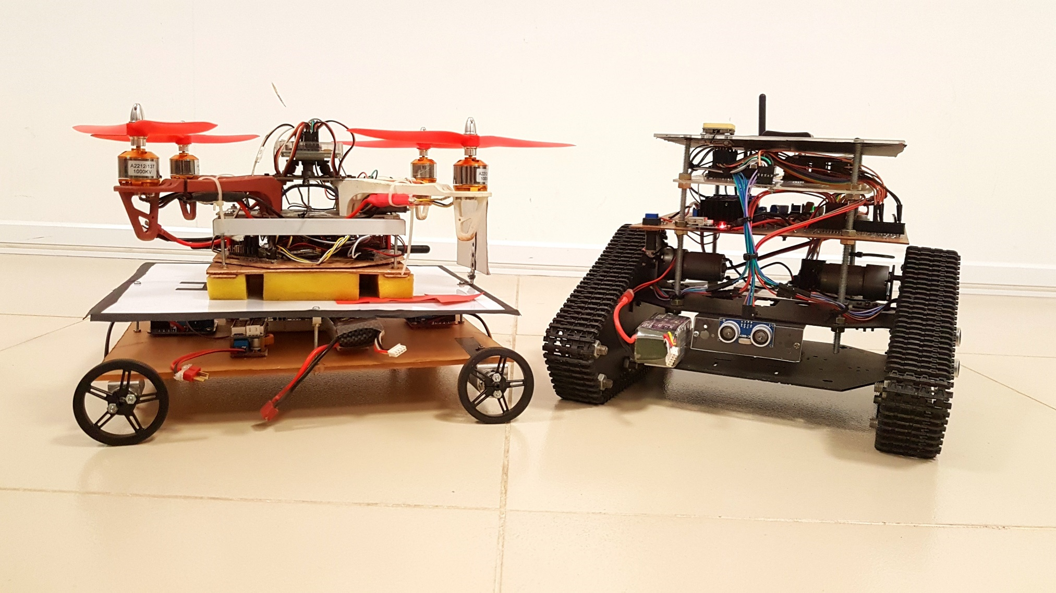
Mobile Robot Implementation
Figure 17. Mobile Robot

Slide 21
Methodology
Figure 18. Mobile Platform Implementation Methodology

Slide 22
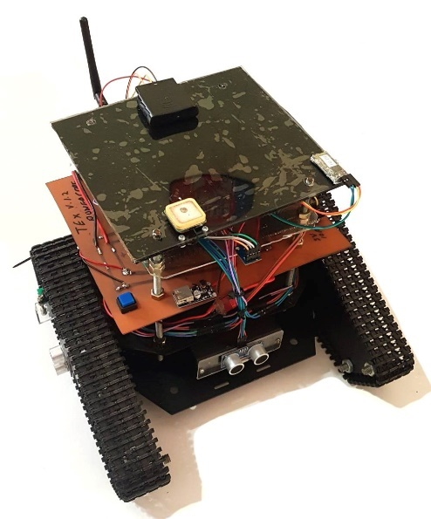
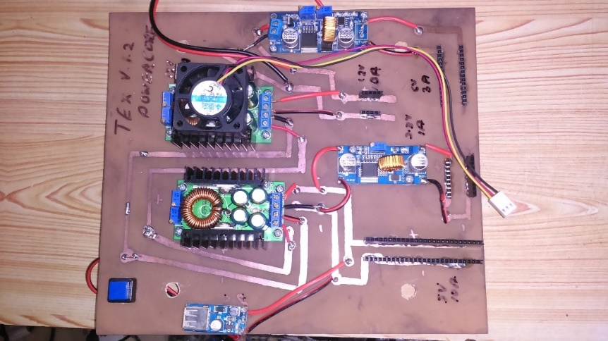

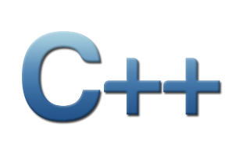
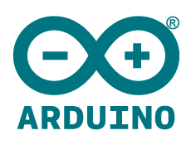
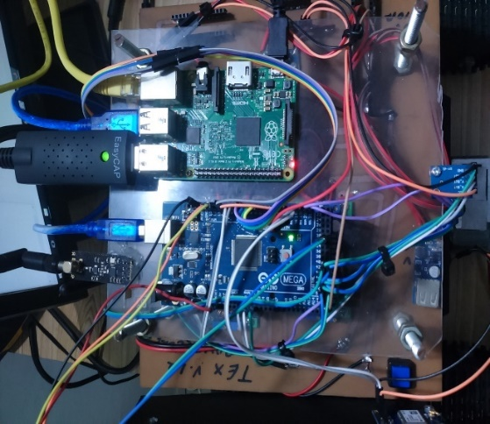

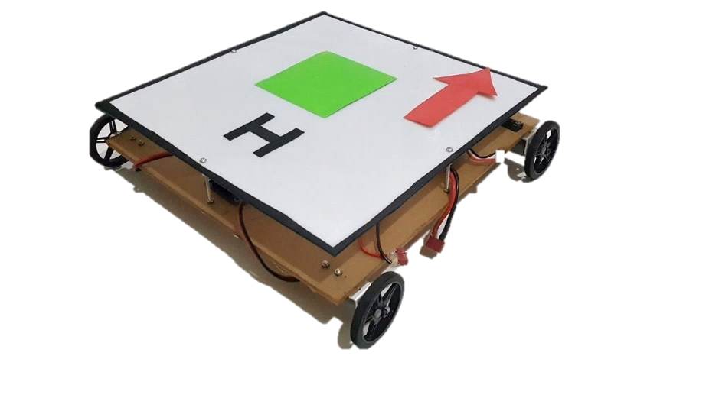
Mechanical Electronic Software
Figure 19. Design of Mobile platform

Slide 23
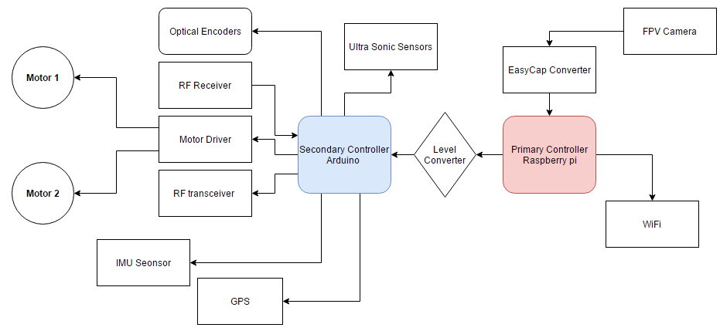
Electronic Configuration
Figure 20. Electronic Configuration

Slide 24
Image Processing Methodology
Figure 21. Image Processing block diagram

Slide 25
Kalman filter
The use of accelerometer and gyroscope to hovering the quadcopter properly, requires a math filter in order to merge the signals returned by the sensors.
The gyroscope has a drift and in a few time the values returned are completely wrong.
The accelerometer, from the other side, returns a true value when the acceleration is progressive but it suffers much the vibrations, returning values of the angle wrong.
The kalman filter is used to mix and merge these two values, in order to have a correct value.

Slide 26
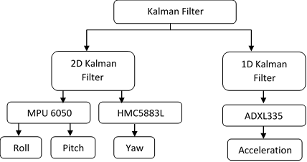
The flow chart of kalman filter used in IMU Sensors
Figure 22. Use of Kalman filter

Slide 27
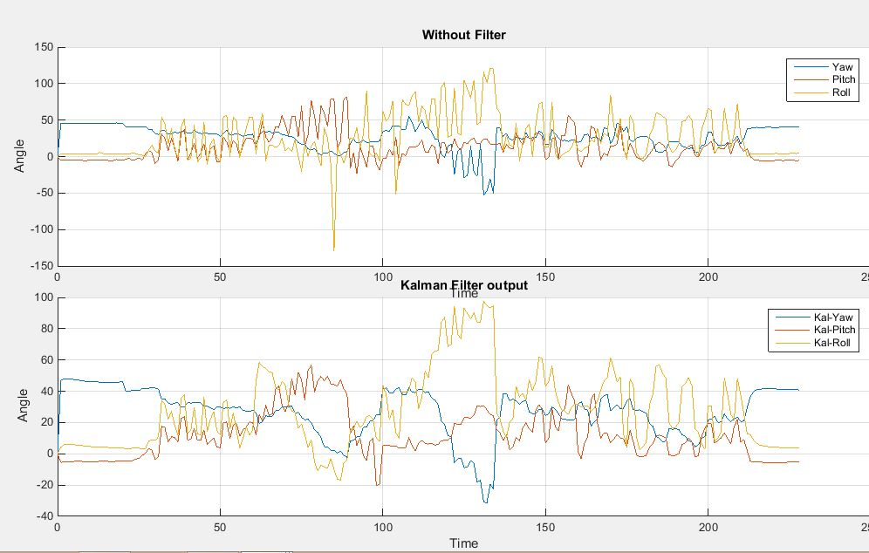
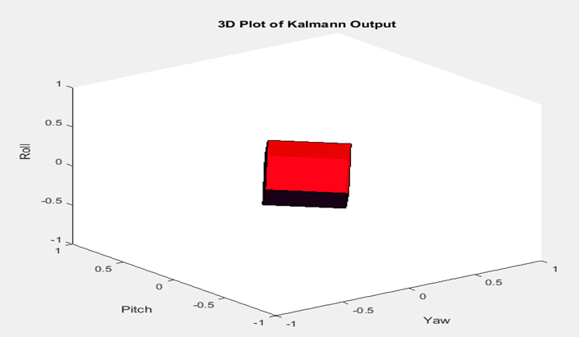
The matlab serial monitor
The matlab serial monitor is implemented for checking the kalman filter output before applying the quadcopter in the real world.
(b)
(a)
Figure 23. (a) Real-time raw vs. Kalman filtered output (b) 3D representation of the sensor

Slide 28
Results

Slide 29
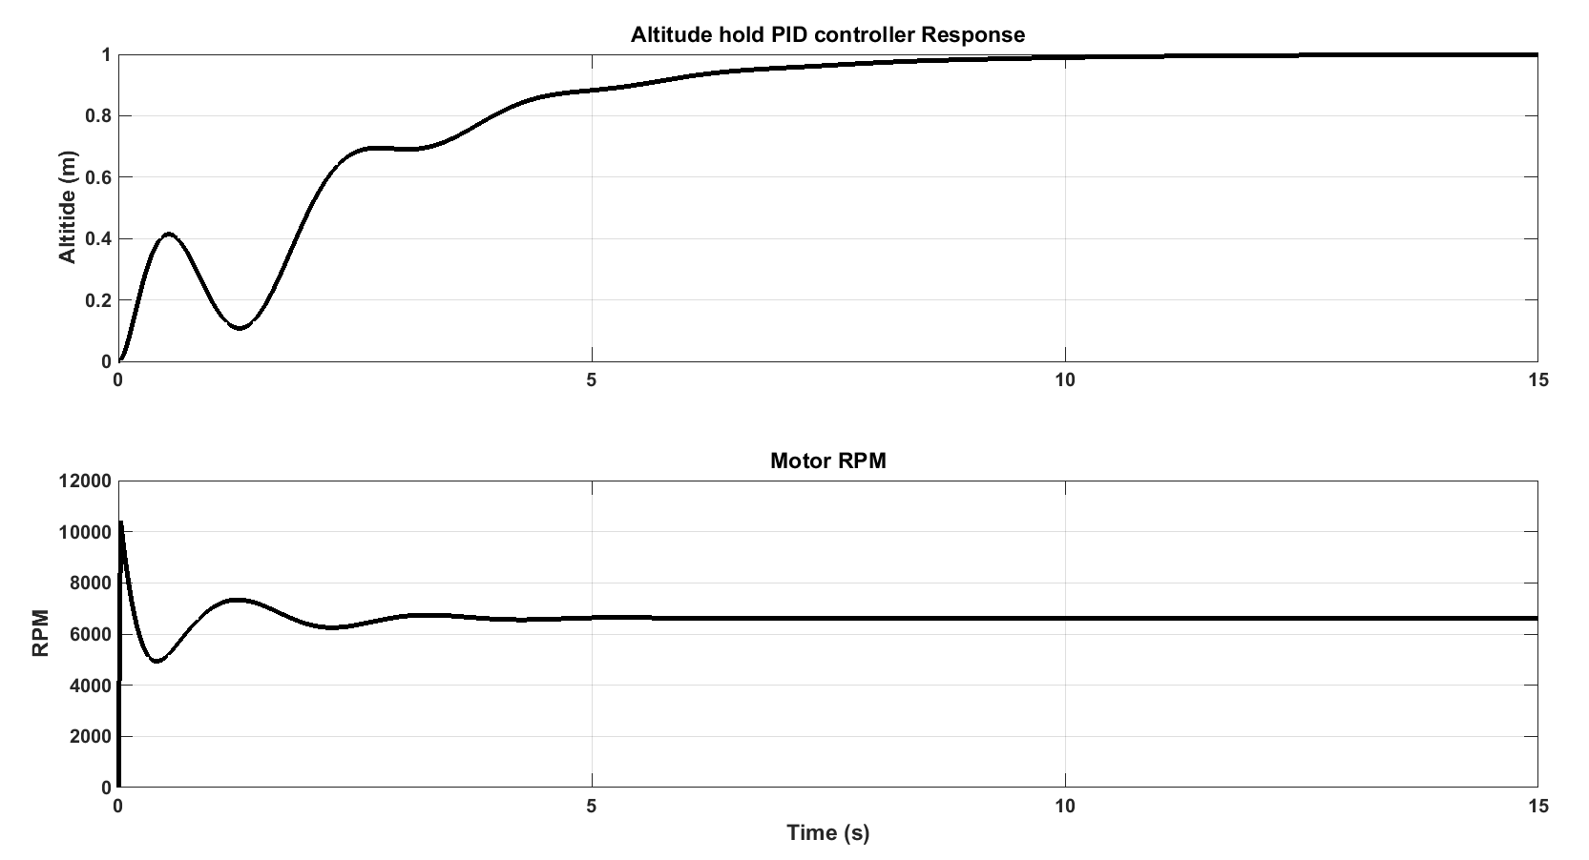
Altitude hold PID simulation results
Kp = 9
Ki = 4
Kd = 2
Figure 24. Altitude hold PID controller results
Notes:
RPM of a single motor 2. altitude of the quad 3. full vertical thrust from the motors.
X axis data
Results seperatly

Slide 30
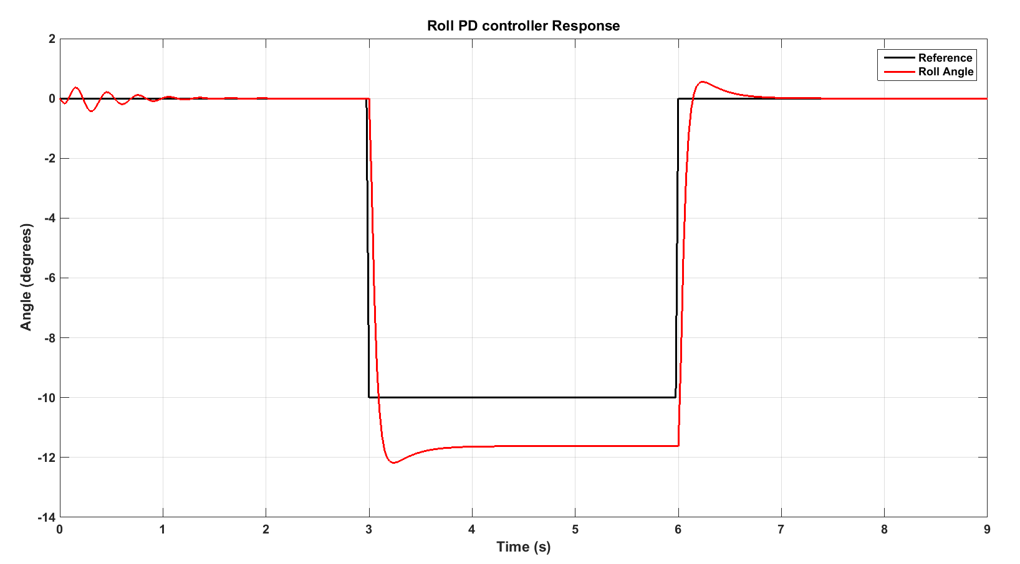
Roll PD controller simulation results
Kp = 40
Kd = 10
Figure 25. Roll PD controller results
Notes:
1. Shows the reference 2. shows the actual output.

Slide 31
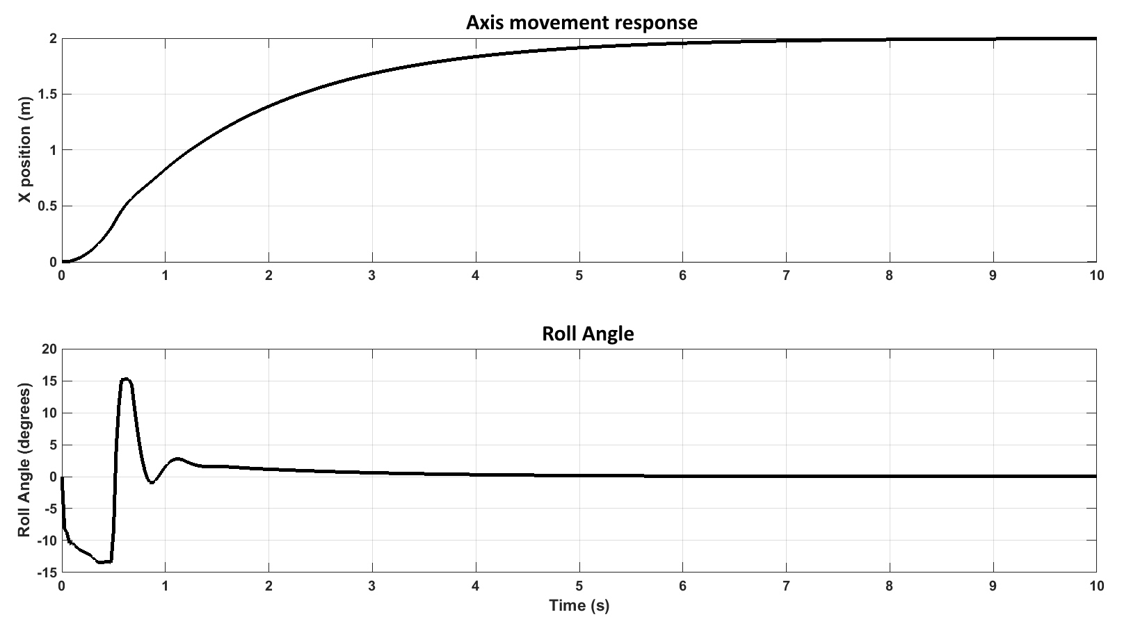
Axis movement controller simulation results
Kp = 40
Kd = 60
Figure 26. Axis movement controller results
Notes:
X direction position
Roll angle of the quadcopter

Slide 32
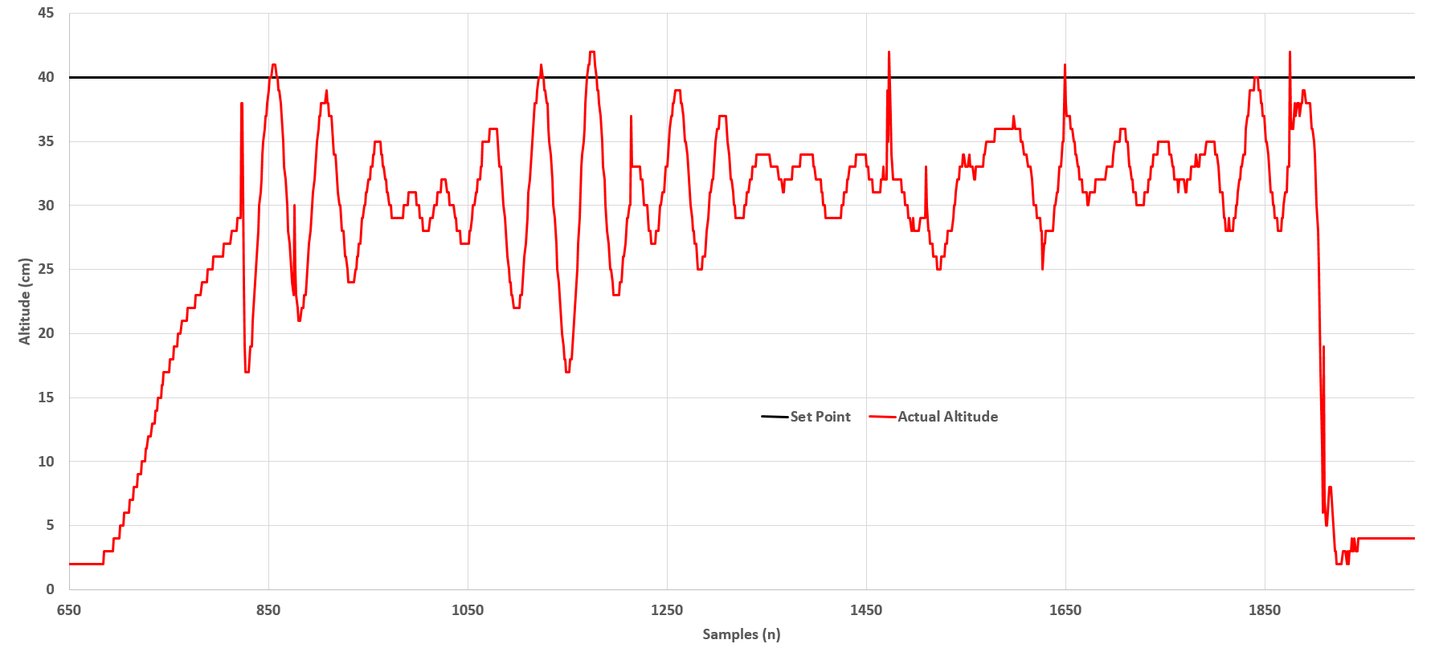
Experimental Altitude hold PID controller
Kp = 1.01
Ki = 20.01
Kd = 0.000003
Figure 28. Experimental altitude hold results
Notes:
Results of experimental altitude hold PID controller. Takeoff is clearly shown. As you can see there are a lot of Oscillations. Which means there’s room for PID tuning. The sudden down falls are due to the weight of the quad. Explain the weight problem – full throttle should produce double weight.
Larger fonts

Slide 33
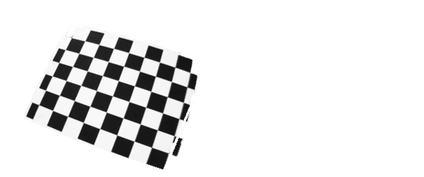
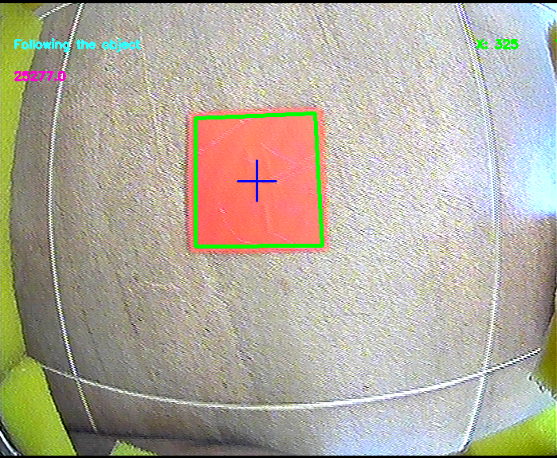
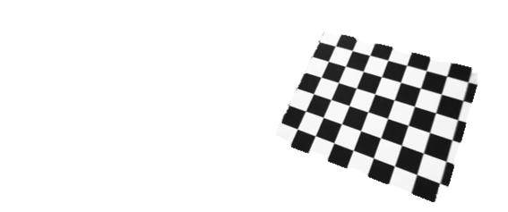
Camera Calibration
Figure 29 (b). Before Calibration
Figure 29 (a). Raw Snap Shot from FPV CAM
Figure 29 (c). After Calibration

Slide 34
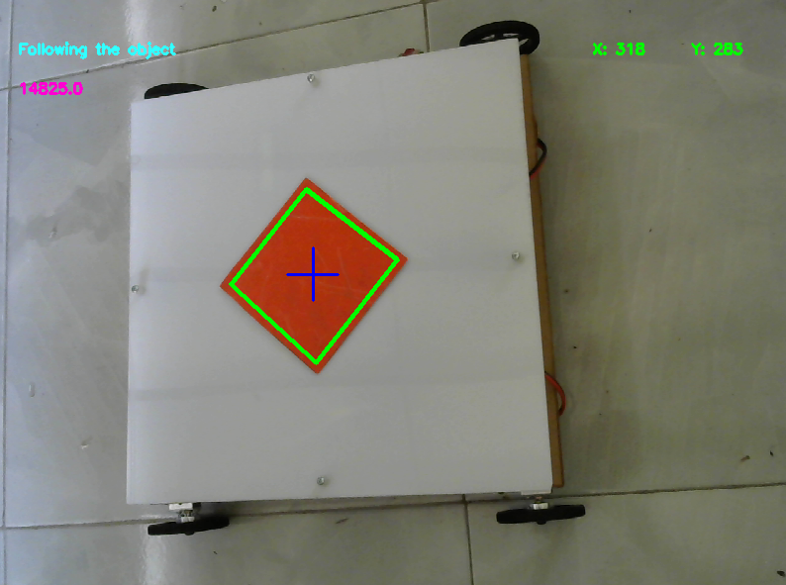
Center Coordinates Using Image Processing
Figure 30. Real-time X, Y coordinate extraction

Slide 35
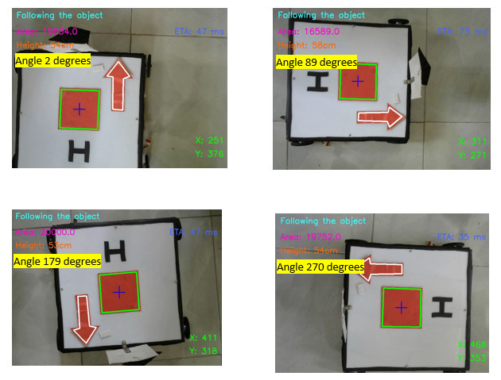
YAW Orientation using image processing
Figure 31. Yaw Orientation extraction

Slide 36
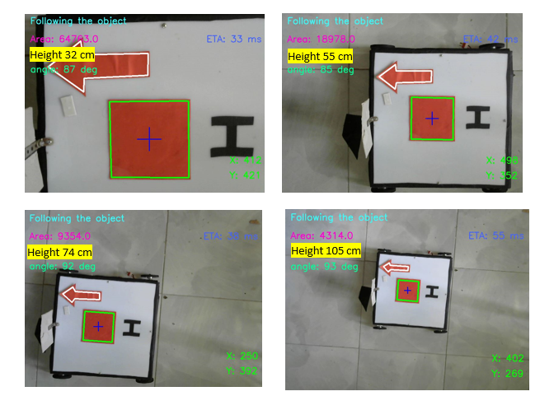
Height Estimation
Figure 32. Height Estimation

Slide 37
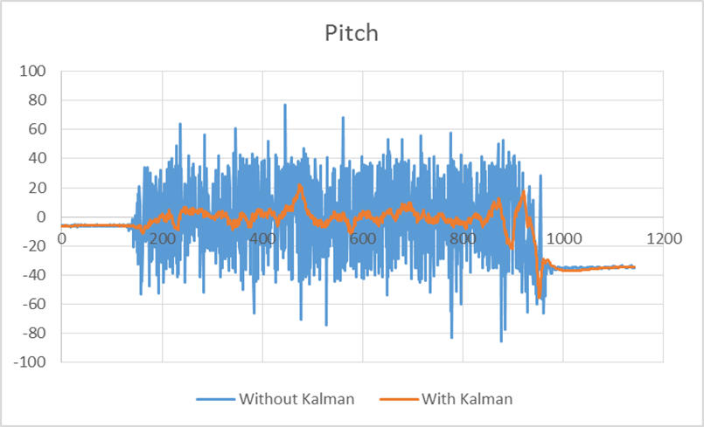
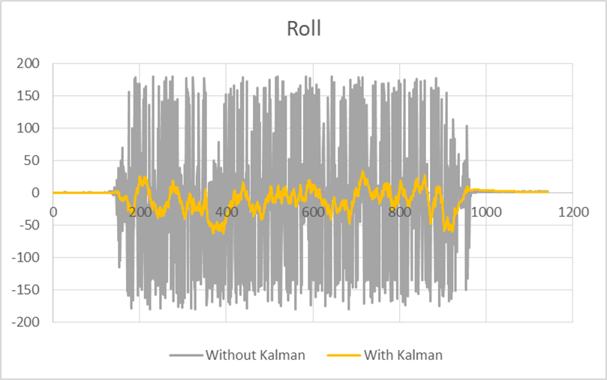
The Kalman filter output when quadcopter in air
(a)
(b)
Figure 34. Kalman filter Raw vs. filtered (a) Pitch (b) Roll

Slide 38
Conclusion
An autonomous takeoff, altitude hold hovering and landing capable controller was developed for the F330 quadcopter.
Autonomous takeoff and landing works accurately. The altitude hold PID controller works well, but there’s room for fine tuning.
Because of increase in weight, rapid battery discharging, fine tuning the PID controller is difficult.
Altitude hold controller works well within +/-5 cm of the set point up to 70 cm.
Simulation and experimental values of the PID controller were different
Notes:
6 points max
1. What we did
2. Outcome
3. Accuracy of results
4. Limitations of the project

Slide 39
Future work
Change the quadcopter to DJI F450 model
Custom made flight controller
Gimbal for sensor panel
Replace sonar sensor by LiDAR sensors
Pose Estimation using ArUco markers

Slide 40
Reference
Design and Implementation of a Quadcopter with Visual Control 2016 [ONLINE] Available at: http://www.es.ele.tue.nl/education/5HC99/wiki/images/0/0f/ Report_ group3 .pdf. [Accessed 17 April 2016].
Lindsay Kleeman. 2000. Understanding and Applying Kalman Filtering. [ONLINE] Available at: http://biorobotics.ri.cmu.edu/papers/sbp_papers/integrated3/kleeman_ kalman_ basics.pdf. [Accessed 15 July 2016].
L. S. D. A. E. Ser-Nam Lim, "A Scalable Image-Based Multi-Camera Visual Surveillance System," University of Maryland, College Park,Computer Vision Laboratory,UMIACS, Maryland.
N. Instruments, "PID Theory Explained," 29 mar 2011. [Online]. Available: http://www.ni.com/white-paper/3782/en/. [Accessed 15 09 2016].

Slide 41
Thank you

Slide 42
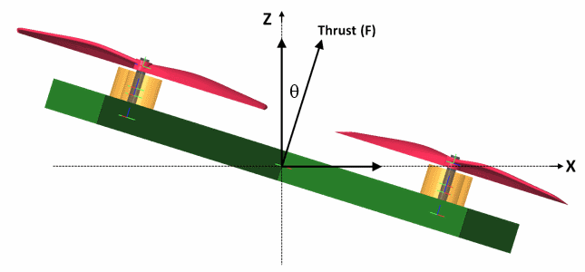
Axis movement controller simulation
(a)
(b)
Figure 11. (a) Forces acting on the quadcopter (b)
Notes:
A PD controller is used to move the quadcopter in x direction. The set point is the X direction position in meters. The output of the PD controller is the angle which the quad should turn to move in x direction. This angle is then inserted to the roll PD controller. The resultant force in x direction is inserted to the prismatic joint.

Slide 43
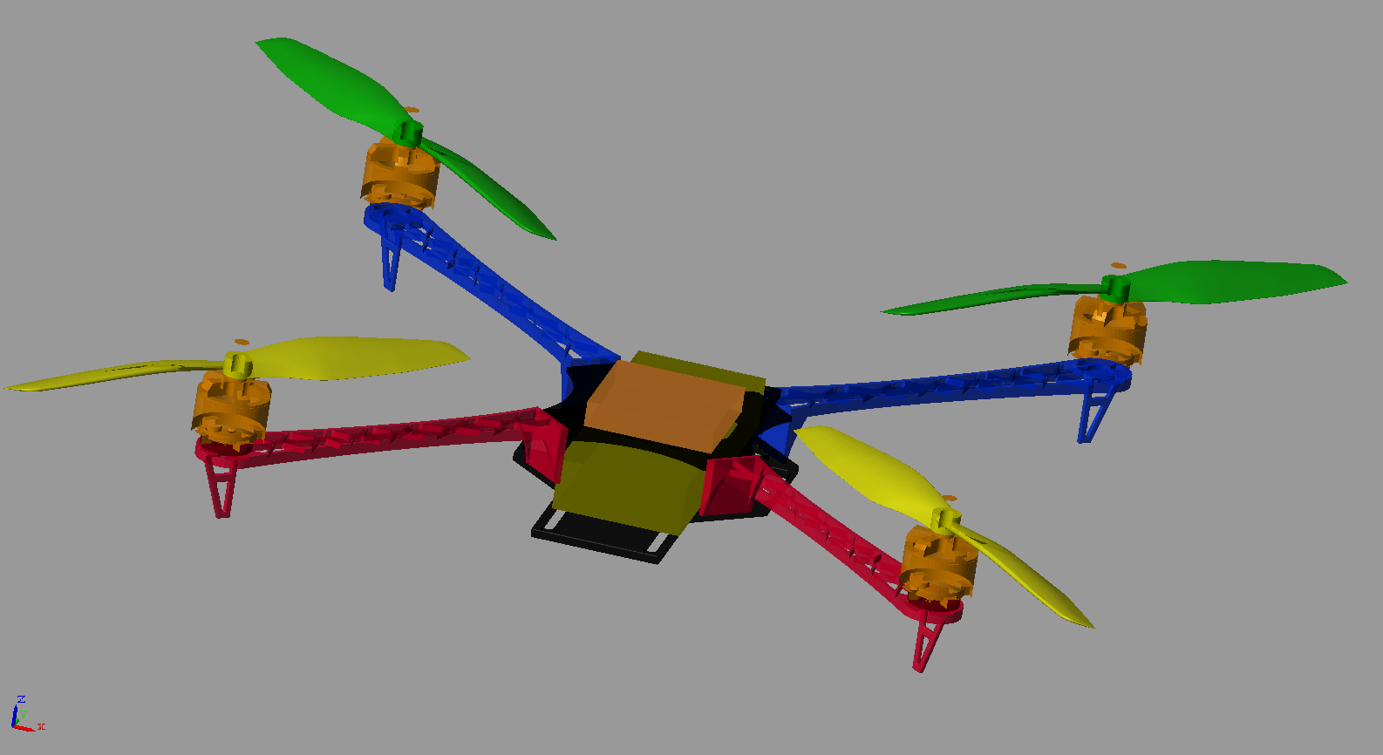
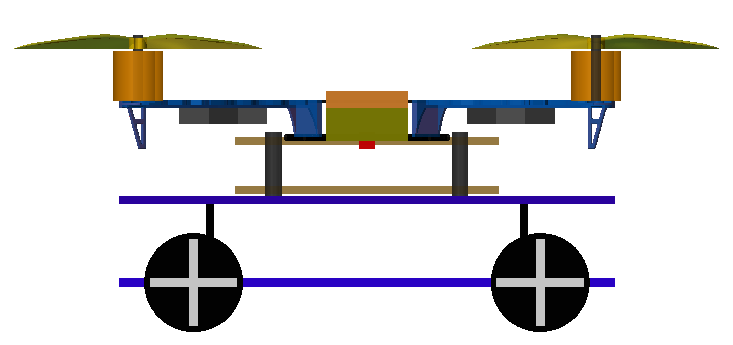
System simulation using Simulink
(a)
(b)
Figure 5. F330 quadcopter model in Simulink (a) Quadcopter (b) quadcopter on the mobile robot
Notes:
(a) Shows the 3D model of the quadcopter implemented in Simulink. (b) shows the quadcopter on the mobile robot.

Slide 44
System simulation using Simulink
Figure 7. P controller for constant RPM
Notes:
In the simulation, all the revolute joints relevant to the motors are ideal, which means there is no friction. So when some amount of torque is applied, the joint will accelerate. But in practical motors this doesn’t happen. So to replicate that, a P controller is used with each motor to keep them running at a constant angular velocity. (a) shows how the p controller is implemented in simulation. (b) shows the input and output parameters used with each motor in the simulation.

Slide 45
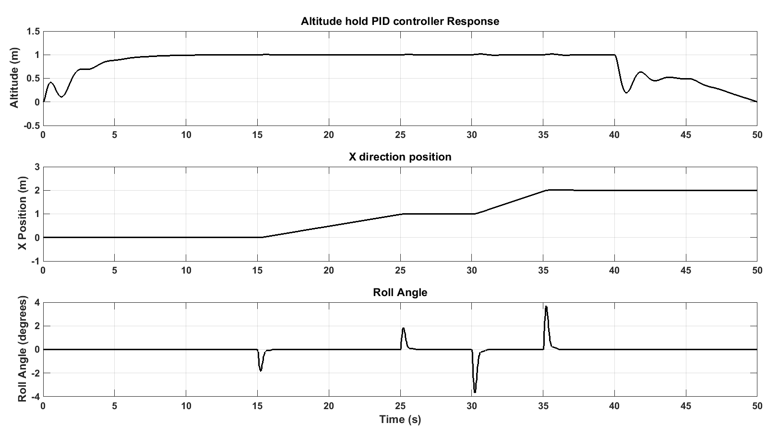
Full system simulation results
Figure 27. Full system simulation results
Notes:
Altitude
X direction position
Roll angle

Slide 46
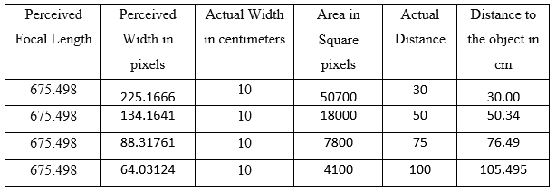
Actual vs Measured
Figure 33. Height Estimation Actual Vs. Measured comparison

